Slide 1
Microsoft R Server Overview
Data Science and Machine Learning Education Team

Slide 2
What is R?
Open-source programming language for statistical computing
Free (cran.r-project.org)
Highly extensible
Focused on statistics and machine learning
Transparent and reproducible
Single-threaded
Data stored in memory

Slide 3

A brief history of R
1993
Research project in Auckland, NZ
1997
R-core
2003
R Foundation
2009
New York Times
1995
Open source
2000
R-1.0.0
2004
First UseR!
2015
R-3.2.0
R Consortium
Photo credit: Robert Gentleman

Slide 4
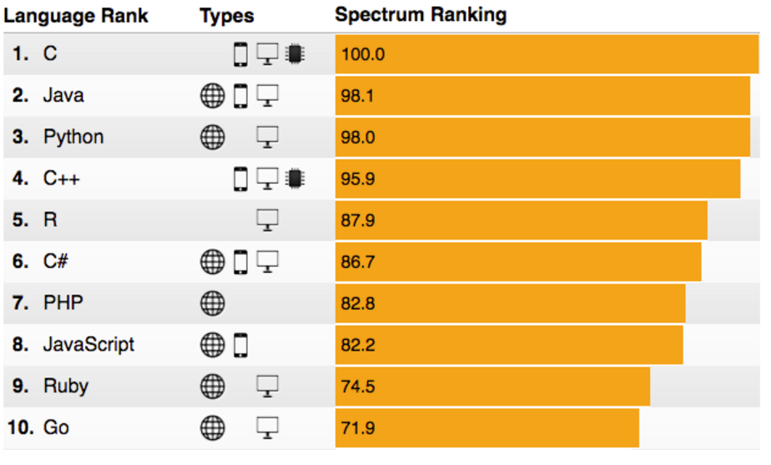
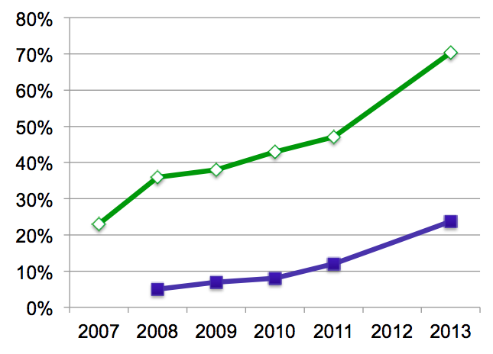
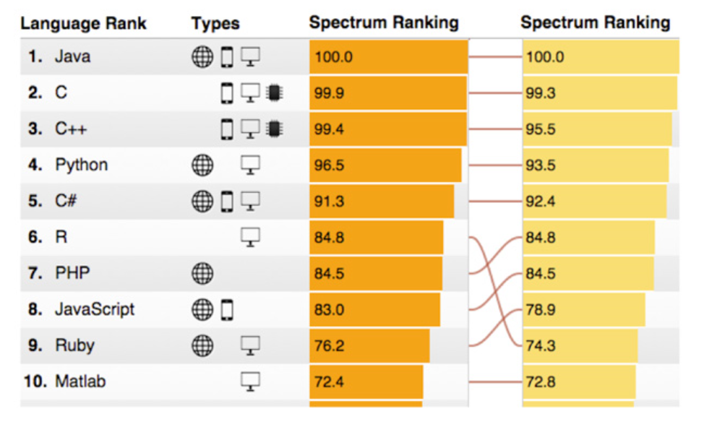
R’s popularity is growing rapidly
Language Popularity
IEEE Spectrum Top Programming Languages
R Usage Growth
Rexer Data Miner Survey, 2007-2013
2015
2014
80%
0%
2007
2008
2009
2010
2011
2012
2013
Primary Tool
Use for Data Science
Rexer Data Miner Survey
IEEE Spectrum 2014 – 2016
Notes:
Slide objective
Introduce the popularity of the R language vs. other analytics languages.
Talking points
R is enjoying an unstoppable wave of popularity
In 2015, it moved from the #9 most frequently used language to #6.
Only general purpose languages are more frequently used than R.
Notes:

Slide 5
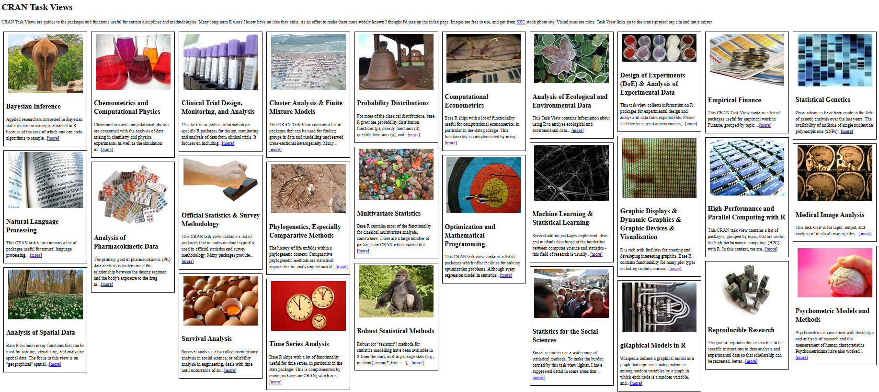
CRAN
The Comprehensive R Archive Network
In addition to CRAN, Bioconductor, GitHub, others distribute R packages
Notes:
CRAN Task View by Barry Rowlingson: http://www.maths.lancs.ac.uk/~rowlings/R/TaskViews/

Slide 6
Microsoft R Server
MRS extends open-source R to allow:
Multi-threading
Matrix operations, linear algebra, and many other math operations run on all available cores
Parallel processing
ScaleR functions utilize all available resources, local or distributed
On-disk data storage
RAM limitations lifted – Break Through Your Memory Barrier!

Slide 7
Microsoft R Server family
From Data To Action On Premises
Data Sources
People
Cortana Intelligence
+
Apps
Apps
Sensors and devices
Automated Systems
Microsoft R Server & SQL R Services
DATA
INTELLIGENCE
ACTION
Notes:
Slide Objective
Introduce the two product families and transition to high-level product overviews.
Talking Points
Microsoft brings two complementary product lines to bear on the challenges of Advanced Analytics.
Cortana Intelligence Suite provides a rich, end-to-end, cloud-based advanced analytics capability.
Microsoft’s R Server and SQL R Services products leverage a predominantly on-premises point of view – designed for users with significant investments in on-premises data, data repositories, and application portfolios.
Notes
Avoid being dragged into a direct comparison of the two products. There is not a clear answer until much more is known about the audience and their challenges.
If you get dragged into this discussion you may well lose the remainder of your time.

Slide 8

What is
Language
Platform
A statistics programming language
A data visualization tool
Open source
Community
2.5+M users
Taught in most universities
New and recent grad’s use it
Thriving user groups worldwide
Ecosystem
10,000+ free algorithms in CRAN
Scalable to big data
Rich application & platform integration
Notes:
Slide objective
Establish that R is a language is as important for the community that uses it an the capabilities written to extend it than the language itself.
Talking points
Part 1 of the R World is The R language, developed specifically for data analysis – particularly among statisticians and mathematicians.
[optional points]:
Developed in New Zealand, release in roughly 2000.
Maintained by the R Foundation which releases new editions of R every few weeks.
Licensed under GPL open source license.
R directly supports complex data manipulation operations making them extremely simple for users, particularly those with greater depth in statistics and mathematics than in computer science.
Huge community of users across industry, government and academia use R daily.
There are R user groups in most major cities. Some of them very active and very large. Suggest that users look at MeetUp for local groups that meet regularly.
Most important to the value of R is the huge repository of freely exchanged, algorithms, techniques, scripts, adapters, techniques, training available.
Introduce CRAN: “The Comprehensive R Archive Network”.
Data access & integration
Data transformation
Data profiling
Data visualization
Predictive analytics
Machine Learning
CRAN contains over 7000 (and growing) contributed packages. Many algorithms, test data, comments on usage, etc. One package contains hundreds of algorithms packaged as a library.
All are designed to run with the R language.
CRAN is the largest but not the only. Thousands of additional algorithms, visualizations and tools are available from BioConductor, GitHub and other repositories.
Notes

Slide 9
Challenges posed by open source R
?
?
$?
Limited Data Scale
Inadequate
Modeling Performance
Lack of Commercial Support
Complex Deployment
Processes
Notes:
Slide objective
Introduce how the use of open source R for machine learning and advanced analytics has been limited to a narrow user base of data scientists. Related to this, also discuss how many challenges and complexities remain for advanced analytics in the marketplace.
Talking points
Today, advanced analytics using open source R are being performed only by highly trained and specialized data scientists, mathematicians, and analysts who can create and nurture these models. This means that many challenges and complexities remain in the marketplace.
First, many companies cannot negotiate the increasing costs of specialized talent, infrastructure, and machine learning tools that make total cost of ownership (TCO) and return on investment (ROI) uncertain.
Second, siloed and cumbersome data management restricts access to data and poses limitations on what data can be included in models.
Third, trying to collaborate across complex and fragmented technologies tends to limit agility and reduce participation in exploring data and building models. People end up struggling with the technology instead of focusing on the business problem at hand.
Finally, many models never achieve business value because it’s so difficult to deploy them to stable production environments. If you can imagine spending hundreds of thousands of dollars on a solution and having it never go into production, you can see why machine learning has been so niche up to this point.
Notes

Slide 10
R from Microsoft brings
Peace of mind
Efficiency
Speed and scalability
Flexibility and agility
Notes:
Slide objective
At a high level, describe the evolution of predictive analytics technology and its current state in the marketplace. Also, introduce the related value proposition of combining the R programming language with the Microsoft data platform.
Talking points
Data is the currency of modern business; from the cloud to on-premises and everything in between, access to data anytime, anywhere from varied sources has become a requirement for successful planning and operation. Today, the R open source programming language enables organizations to move beyond reacting to data after the fact, and begin predicting results and gathering proactive insights to help plan ahead.
Basically, an evolution is taking place.
The rise of machine learning and advanced analytics gives us the ability not only to look at historical data to understand what happened and why, but also to harness predictive analytics to peer into the future. With predictive analytics, we can better understand what is likely to happen and identify what actions should be taken so businesses can automate outcomes.
Again, to date, R has been available only as open source. But now that’s changed, and Microsoft is introducing a new value proposition.
With R from Microsoft, you get:
peace of mind,
Efficiency,
Speed and scalability,
And flexibility and agility.
Notes

Slide 11

Microsoft R portfolio
Microsoft R portfolio
Community
Commercial
SQL Server
R Services
R Open
R Server
Windows
Linux
Hadoop
Teradata
Spark
Notes:
Slide objective
Show broad commitment to R by preserving freely available, enhanced editions, Windows and SQL Server editions and R Server editions for leading EDWs, Linux and Hadoop platforms.
Differentiate free, open editions from commercial by mentioning availability of commercial 24x7 support, and enhancements to support very large scale data analytics at speed.
Talking points
Notes

Slide 12
Microsoft R Scales to Big Data for Enterprises
Escapes R’s traditional memory limits
Scales predictive modeling using parallelization
Distributes computation cores & nodes
Minimizes data movement using in-database, in-MapReduce and in-Apache Spark execution
f(x)
Notes:
First, Cortana Intelligence provides services to bring data in, so that you can analyze it. It can be any type of data – structured, unstructured, stored in relational or non-relational sources, you name it. This can be data from inside your business, from traditional customer and operations data to IoT data streaming in from devices and sensors. It can also be data from external sources like, social media feeds. That data can be fed into various storage locations, and can be used in whatever downstream analytics and business applications you see fit.
The data brought in can then be stored in flexible big data storage services. Because it’s in the cloud, you can achieve massive global scale, and can easily scale up or down depending on demand. The cloud gives you an almost infinite set of computing resources. This means that you never have to worry about straining your capacity when high-volume events occur, whether they’re planned or unplanned. That might be a peak season of the year, an unexpectedly popular promotion that sets off a social media deluge, you name it. Cloud is key to handling massive amounts of data in a cost-effective way.
And because it’s all in the cloud, you only pay for what you use. This in itself saves you money for anything that has variable computing needs. For some organizations, there is also an additional benefit of changing CapEx to OpEx, which frees up capital from infrastructure investments so it can be put to other uses.
<Transition>: Next, let’s cover analytics.
Slide objective
.
Talking points
.
Notes

Slide 13
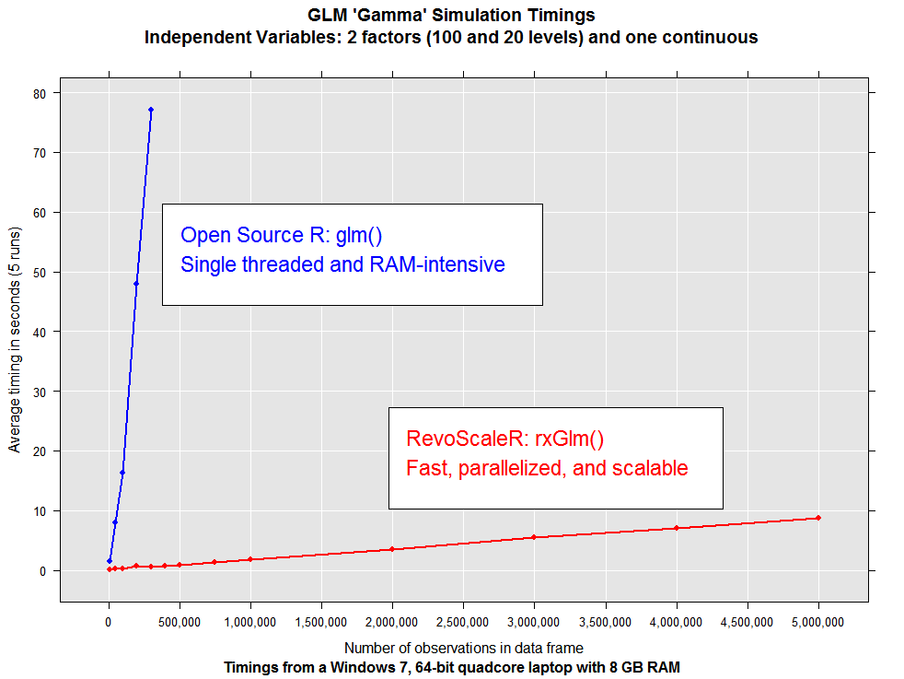
Scalable algorithms
Notes:
Slide objective
Illustrate the potential scale benefits possible with R Server’s ScaleR algorithms.
Show a representative example and explain the 3 mechanisms that help achieve the improvements.
.
Talking points
We tested the improved data and computational scale of the R Server’s ScaleR library of enhanced, parallelized algorithms. This is an example.
Speed:
On a 4 core laptop, with 8GB of RAM, open source R could process about 300,000 events in a particular data set prior to exhausting available memory.
The test tool about 77 seconds to run the most commonly used R linear regression algorithm called “lm”.
We than ran the same test using our parallelized, rewritten (in C++) linear regression module called rxLinMod.
Data Scale
Algorithms in the ScaleR library are also rewritten to analyze data in “chunks” to eliminate the memory-limits of typical open source R algorithms.
Where the open source lm exhausted memory at about 300,000 events, the improved rxLinMod was working fine at 5 million events where we stopped testing.
The result is a 50x performance improvement over open source linear regression, and no memory limits.
Parallel Scale
This example shows only the effects of running optimized, compoiled code on all cores of a laptop. Greater benefits are available.
What is not shown, is that the work done to parallelize across 4 cores can also be utilized to scale across many nodes in systems such as EDWs and Hadoop.
While results vary, the system, as you can see, responds linearly with respect to data size. Rehosting using R Server for Hadoop can provide even more dramatic speed and scale results.
Notes

Slide 14
Introducing Microsoft R Server
Linux, Windows, Hadoop & Teradata
High-performance, Scalable R
100% open source R
CRAN, Bioconductor, MRAN, GitHub compatibility
Big-data connectivity
Scalable analytics
Multi-platform
In-database, in-cluster scalability
Choice of IDE
R Server Technology
CRAN
Microsoft R Open
Remote Execution
Machine Learning
PEMA / ScaleR
HDInsight/SQL Integration
Open Source Components
Licensed Components
Notes:
Microsoft R Server is a broadly deployable enterprise-class analytics platform based on R that is supported, scalable and secure. Supporting a variety of big data statistics, predictive modeling and machine learning capabilities, R Server supports the full range of analytics – exploration, analysis, visualization and modeling
Slide objective
Introduce the high –level value of R Server and R Services over other instantiations of the R language.
Talking points
R Server products provide an enhanced experience for the R User without loss of compatibility
R Server products are “open core” – the utilize the open source R product entirely and build new capabilities around that core without impacting compatibility.
Users of R Server products enjoy full compatibility with open source compatible with the entire (and vast) collection of algorithms, connectors, visualization tools shared openly via CRAN, Bioconductor and other shared resources like GitHub.
Key extensions enable R to tackle big data challenges that exceed the capacity of open source R.
R Scripts built for one platform using R Server can be easily run on another platform running R Server
We call it WODA – write once, deploy anywhere.
Two key contributions:
Build on any version of the product and deploy using other versions
Investment protection as platform choices change
Develop on the desktop and immediately deploy to RDBMS – SQL Server, EDW (SQL Server & Teradsata) or Hadoop (Microsoft, Cloudera, Hortonworks and MapR)
Notes

Slide 15
Introducing SQL Server 2016 R services
Simplicity and agility
Scalability and choice
Cost effectiveness
Enterprise speed and scale
Near-DB analytics
Parallel threading and processing
Reuse SQL skills for data engineering
In-database deployment
Memory and disk scalability
No R memory limits
Write once, deploy anywhere
Included in SQL Server 2016
Reuse and optimize existing R code
Eliminate data movement
Notes:
Slide objective
Introduce the three value proposition pillars of SQL Server 2016 R Services.
Talking points
SQL Server 2016 R Services brings the perfect mix of fast querying and In-Memory OLTP optimization from SQL Server 2016, as well as data exploration, predictive modeling, scoring, and visualization from the R Services family of products.
It delivers unprecedented enterprise speed and performance for advanced analytics, thanks to near-database analytics and parallel threading and processing.
It also delivers scalability and choice not seen before from a stable, commercial platform for advanced analytics. Its on-premises, cloud, and hybrid benefits, as well as its limits with large datasets, are unmatched.
Finally, there is no additional cost because the offering is included in SQL Server 2016. In addition, the ability to reuse existing R code and eliminate data movement across machines provides significant value.
Notes

Slide 16
Portability & investment assurance
Windows
Linux
HDInsight
Cloud
Hortonworks
Cloudera
MapR
Hadoop & Spark
R Server Technology
R Server portfolio
EDW
SQL Server 2016
Teradata Database
CRAN
Microsoft R Open
Remote Execution
RDBMS
SQL Server 2016 EE
SQL Server 2016 SE
Machine Learning
PEMA / ScaleR
Desktops & Servers
Windows
Linux
HDInsight/SQL R Services
Write Once – Deploy Anywhere
Notes:
…. In the multi-platform world of on-premises…
Slide objective
Differentiate R Server from other R offerings such as vendor-specific offers from Oracle, HP, SAP and Teradata
Clearly communicate two benefits – develop on multiple machines, and protect investments from platform change disruptions later.
.
Talking points
R Server makes your data scientists’ jobs easier. By running identically on multiple platforms, users can build on one platform, the move the scripts to another. This has several advantages:
Run modeling algortihms on systems here larger compute or data storage is available.
It also permits modesl to be built on one platform, but model scoring or operationalization to take place elsewhere.
Finally, with the availability of very low storage and compute costs in the cloud, users can load, transform, visualize, study and model data in the cloud, but actually run the model computations on on-premises systems.
Perhaps more importantly, however, portability across systems protects organizations investments in R-based data science.
The best best big data storage and compute platform for today may not be the best choice tomorrow.
Compatibility across systems brings the possibility to avoid disruptive recoding efforts when such changes occur.
Notes
Two ways to underscore this point are to describe the range of compatibility available with other vendor’s R versions. Oracle R, because it works only with algorithms running on Oracle Database, is not portable. The same is true for R implementations from Teradata, HP Vertica, SAP and others. They are in essence platform specific.
Another way to describe the problem is with a fictitious story: Imagine a CIO who has to tell his data science team “we’re changing platfomrs, and therefore, you need to change all your programs and scripts to work with the new platform”.

Slide 17
MRS in Different Contexts
On a workstation, that means:
All available cores will be used for math operations and parallel processes
Hard drive capacity sets limit for data size, not RAM
On a cluster:
Parallel utilization of all available nodes
Distributed file systems like HDFS greatly expand possible data sizes

Slide 18
MRS in Different Contexts
Code written on a workstation will run on a cluster by tweaking a single function call:
# Use your local computer:
rxSetComputeContext( LocalParallel() )
# Switch to your cluster:
rxSetComputeContext( RxSpark(...) )

Slide 19
How MRS Works
Parallel External Memory Algorithms (PEMAs)
A chunk/subset of data is extracted from the main dataset
An intermediate result is calculated from that chunk of data
The intermediate results are combined into a final dataset

Slide 20


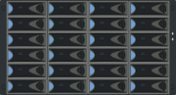



How Does Remote Compute Context Work?
Microsoft R Server “Client”
Microsoft R Server “Server”
Analyze Blocks In Parallel
Load Block At A Time
Big Data
R IDE or command-line
Distribute Work, Compile Results
REMOTE CONTEXT
Work
AlgorithmMaster
Predictive Algorithm
Results
Console
“Pack and Ship” Requests to Remote Environments
Microsoft R Server functions
A compute context defines where to process.
E.g. remote context like Hadoop Map Reduce
Microsoft R functions prefixed with rx
Current set compute context determines processing location
Copyright Microsoft Corporation. All rights reserved.

Slide 21
Available Algorithms
Linear regression (rxLinMod)
Generalized linear models (rxLogit, rxGLM)
Decision trees (rxDTree)
Gradient boosted decision trees (rxBTree)
Decision forests (rxDForest)
K-means (rxKmeans)
Naïve Bayes (rxNaiveBayes)
Note: models available in open-source R packages won’t be made parallel automatically

Slide 22

Parallelized, Remote Execution Algorithms
Data Step
Data import – Delimited, Fixed, SAS, SPSS, OBDC
Variable creation & transformation
Recode variables
Factor variables
Missing value handling
Sort, Merge, Split
Aggregate by category (means, sums)
Statistical Tests
Chi Square Test
Kendall Rank Correlation
Fisher’s Exact Test
Student’s t-Test
Variable Selection
Stepwise Regression
Simulation
Simulation (e.g. Monte Carlo)
Parallel Random Number Generation
Sampling
Subsample (observations & variables)
Random Sampling
Cluster Analysis
K-Means
Descriptive Statistics
Min / Max, Mean, Median (approx.)
Quantiles (approx.)
Standard Deviation
Variance
Correlation
Covariance
Sum of Squares (cross product matrix for set variables)
Pairwise Cross tabs
Risk Ratio & Odds Ratio
Cross-Tabulation of Data (standard tables & long form)
Marginal Summaries of Cross Tabulations
Predictive Models
Sum of Squares (cross product matrix for set variables)
Quantiles (approx.)
Generalized Linear Models (GLM) exponential family distributions: binomial, Gaussian, inverse Gaussian, Poisson, Tweedie. Standard link functions: cauchit, identity, log, logit, probit. User defined distributions & link functions.
Covariance & Correlation Matrices
Logistic Regression
Classification & Regression Trees
Predictions/scoring for models
Residuals for all models
Classification
Decision Trees
Decision Forests
Gradient Boosted Decision Trees
Naïve Bayes
Combination
rxDataStep
rxExec
PEMA-R API Custom Algorithms

Slide 23
Best Uses of MRS
Working with data too big to fit into memory
Building models that take too long to run
Working with clusters and distributed file systems

Slide 24
MRS’s Native Data Format: The XDF File
Chunk-oriented
Easy to distribute to nodes
Fast to append
Column-oriented
Fast retrieval of variables
Pre-computed metadata

Slide 25
Moving Data to Disk
Text files, binary files, databases…
MRS can work directly with many of these formats
Advantages and disadvantages to each
The eXternal Data Frame file (XDF)

Slide 26
Importing to XDF
rxImport
inData
outFile
varsToKeep, varsToDrop
numRows
rowSelection
overwrite
append

Slide 27
Input and Output
inData
CSV, SAS, SPSS, an ODBC connection...
outFile
An XDF file; returns a data frame if left blank

Slide 28
Subset of Variables
varsToKeep
varsToDrop

Slide 29
Subset of Rows
numRows
rowSelection

Slide 30
Data Sources
Data sources are wrappers that help MRS work with different kinds of data
Often implicit, more powerful when explicit
Specify data types, a query to use over ODBC, rows per read, etc.

Slide 31
Data Sources
Text files (delimited, fixed-width, etc)
SAS, SPSS
Teradata
HDFS
Databases via ODBC
Runs in-database in SQL Server 2016

Slide 32
Importing from Databases
Set up ODBC first
Each data source (RxOdbcData) represents one query (not one database)
SQL Server 2016 can run MRS internally; no ODBC required!!!

Slide 33
rxDataStep
Subset rows with criteria (rowSelection)
Select columns by name (varsToKeep, varsToDrop)
Create and modify variables (transforms)
Pull data into an in-memory data.frame

Slide 34
Subsetting Rows
rowSelection takes a logical vector, just like subset()
Chain multiple criteria together with & and |
(Use numRows = N to get the first N rows of a dataset)

Slide 35
Selecting Columns
varsToKeep, varsToDrop
One quirk: can’t keep/drop when inData == outFile

Slide 36
transforms
Create new variables
Modify existing variables
Change variable types
Takes a list of named elements – each a new variable

Slide 37
“Complex” Transformations
Simple transformations depend on a single row of data
Complex transforms depend on multiple rows and/or objects
In a distributed context, that means moving results between nodes

Slide 38
Managing Factors
Factors count as “complex” because levels, level order, and level encodings can vary across chunks
Use rxFactors to create and modify factors
The F() shortcut

Slide 39
How Algorithms Work in Microsoft R Server: Chunk by Chunk
(aka Parallel External Memory Algorithms/PEMAs)
Data just needs to fit on disk
Chunks of data distributed to all available cores/nodes
Intermediate results calculated in-memory for each chunk
Final results assembled in-memory

Slide 40
PEMAs in Context
On a laptop:
Chunks pulled from local disk
All cores process chunks in parallel
Computing cluster
Chunks partitioned across nodes
All cores on nodes process local chunks in parallel

Slide 41
Analyzing Data with MRS
Pre-computed metadata
rxGetInfo, rxGetVarInfo
Summary statistics
rxSummary, rxQuantile
rxCrossTabs, rxCube
Predictive modeling
Regressions: rxLinMod, rxLogit, rxGLM
Decision trees and forests: rxDTree, rxBTree, rxDForest
K-means and Naive Bayes: rxKmeans, rxNaiveBayes

Slide 42
Metadata Retrieval
rxGetInfo, rxGetVarInfo, rxGetVarNames
All calculated on import, and retrieved from the XDF file header

Slide 43
Numeric Variables: rxSummary
Standard summary stats: mean, standard deviation,
minimum, maximum, number missing
Works for groupwise summaries, too
Formula interface

Slide 44
Using Formula Syntax in rxSummary
One variable: rxSummary( ~ arr_delay,
data = flightsXdf)
Two variables: rxSummary( ~ arr_delay + dep_delay,
data = myXdf)
Groupwise: rxSummary(arr_delay ~ dayOfWeek_F,
data = myXdf)
Notes:
See ?rxFormula for more details

Slide 45
Numeric Variables: rxQuantile
Calculates quantiles
... just one variable at a time

Slide 46
Categorical Variables
rxCrossTabs for frequency tables
rxCube for “long” tables
Requires factor inputs
Formula interface:
rxCrossTabs( ~ origin_F : dest_F,
data = flightsXdf)

Slide 47
Modeling Workflow in MRS
Load data (rxImport)
Exploratory analysis (rxGetInfo, rxSummary, rxCube)
Clean data (rxDataStep, rxFactors)
Build a model – or several! (rxLinMod, rxGLM, etc)
Evaluate and Predict (rxPredict)
Notes:
Guide to writing your own algorithm with MRS infrastructure: http://packages.revolutionanalytics.com/doc/8.0.0/win/RevoPemaR_Getting_Started.pdf

Slide 48
Modeling Algorithms
Linear regression (rxLinMod)
Generalized linear models (rxLogit, rxGLM)
Decision trees (rxDTree)
Gradient boosted decision trees (rxBTree)
Decision forests (rxDForest)
K-means (rxKmeans)
Naïve Bayes (rxNaiveBayes)
Notes:
Guide to writing your own algorithm with MRS infrastructure: http://packages.revolutionanalytics.com/doc/8.0.0/win/RevoPemaR_Getting_Started.pdf

Slide 49
Using Formula Syntax in Models
One predictor: rxLinMod(y ~ x, data = myXdf)
Two predictors: rxLinMod(y ~ x + z, data = myXdf)
Two predictors with interaction term: rxLinMod(y ~ x * z, data = myXdf)
Notes:
See ?rxFormula for more details

Slide 50
Some Simple Examples
rxLinMod(mpg ~ hp + wt,
data = mtcars)
rxLogit(delayed ~ dep_time + dayOfWeek_F,
data = flightsXdf)
rxNaiveBayes(Species ~ Sepal.Length + Sepal.Width,
data = iris)
Notes:
See ?rxFormula for more details

Slide 51
Modeling Workflow in MRS
Load data (rxImport)
Exploratory analysis (rxGetInfo, rxSummary, rxCube)
Clean data (rxDataStep, rxFactors)
Build a model – or several! (rxLinMod, rxGLM, etc)
Evaluate and Predict (rxPredict)
Notes:
Guide to writing your own algorithm with MRS infrastructure: http://packages.revolutionanalytics.com/doc/8.0.0/win/RevoPemaR_Getting_Started.pdf

Slide 52
Model Evaluation and Prediction
MRS models don’t include fitted values or residuals by default
Generate fitted values, residuals, and predictions with rxPredict:
# Fitted values: data used to fit model
rxPredict(modelObject = delayMod,
data = flightsXdf,
outData = flightsXdf)
Notes:
Subtract from original values to calculate residuals

Slide 53
Model Evaluation and Prediction
Other options
Residuals: computeResiduals = TRUE
Standard Errors: computeStdErrors = TRUE
Confidence intervals: interval = “confidence”
Prediction intervals: interval = “prediction”
For binary classifiers: rxRocCurve
Compares actual values to one or more predictions generated by rxPredict
Notes:
Subtract from original values to calculate residuals

Slide 54
Modeling Workflow in MRS
Load data (rxImport)
Exploratory analysis (rxGetInfo, rxSummary, rxCube)
Clean data (rxDataStep, rxFactors)
Build a model – or several! (rxLinMod, rxGLM, etc)
Evaluate and Predict (rxPredict)
Notes:
Guide to writing your own algorithm with MRS infrastructure: http://packages.revolutionanalytics.com/doc/8.0.0/win/RevoPemaR_Getting_Started.pdf

